Slide 1
Bus Driver Scheduling
22C:196 High performance Sat and smt solver

Slide 2
Problem Specification
Finding the most efficient way of providing drivers for a given set of bus movements
Several restrictions
Real life legal and logistic considerations
Trade union agreement
Main aim is to make a schedule having minimum number of shifts and lowest total hours of work
Two primary tasks:
Forming potential shifts
Finding out an optimal way of covering all the works by a clever selection of these shifts
Formulation as a set partitioning problem

Slide 3

Input Specification
Given:
Set of tasks to cover (I)
$I=\{1,2,….,m\}$
Set of shifts (S)
$S=\{S1,S2,….,Sn\}$
|S| > |I|
$Sj ⊆I for all j∈J=\left\{1,2,…..,n\right\}$ and each S_{j} has an associated cost > 0
In this case, for all shifts c_{j} = 1

Slide 4
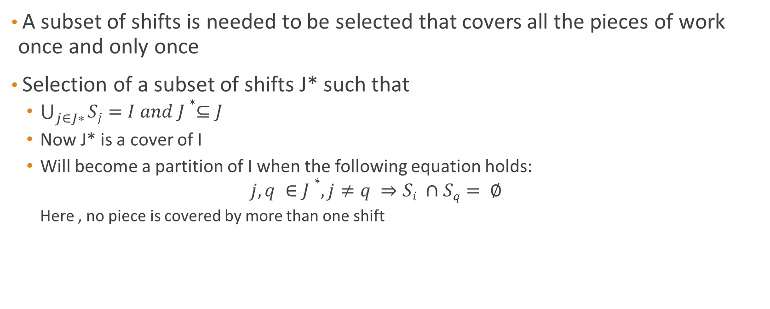
Output Requirement
A subset of shifts is needed to be selected that covers all the pieces of work once and only once
Selection of a subset of shifts J* such that
$\bigcup_{j∈J∗}{Sj=I and J∗⊆J}$
Now J* is a cover of I
Will become a partition of I when the following equation holds:
$$j,q ∈J∗, j≠q ⇒Si ∩Sq= ∅$$
Here , no piece is covered by more than one shift

Slide 5
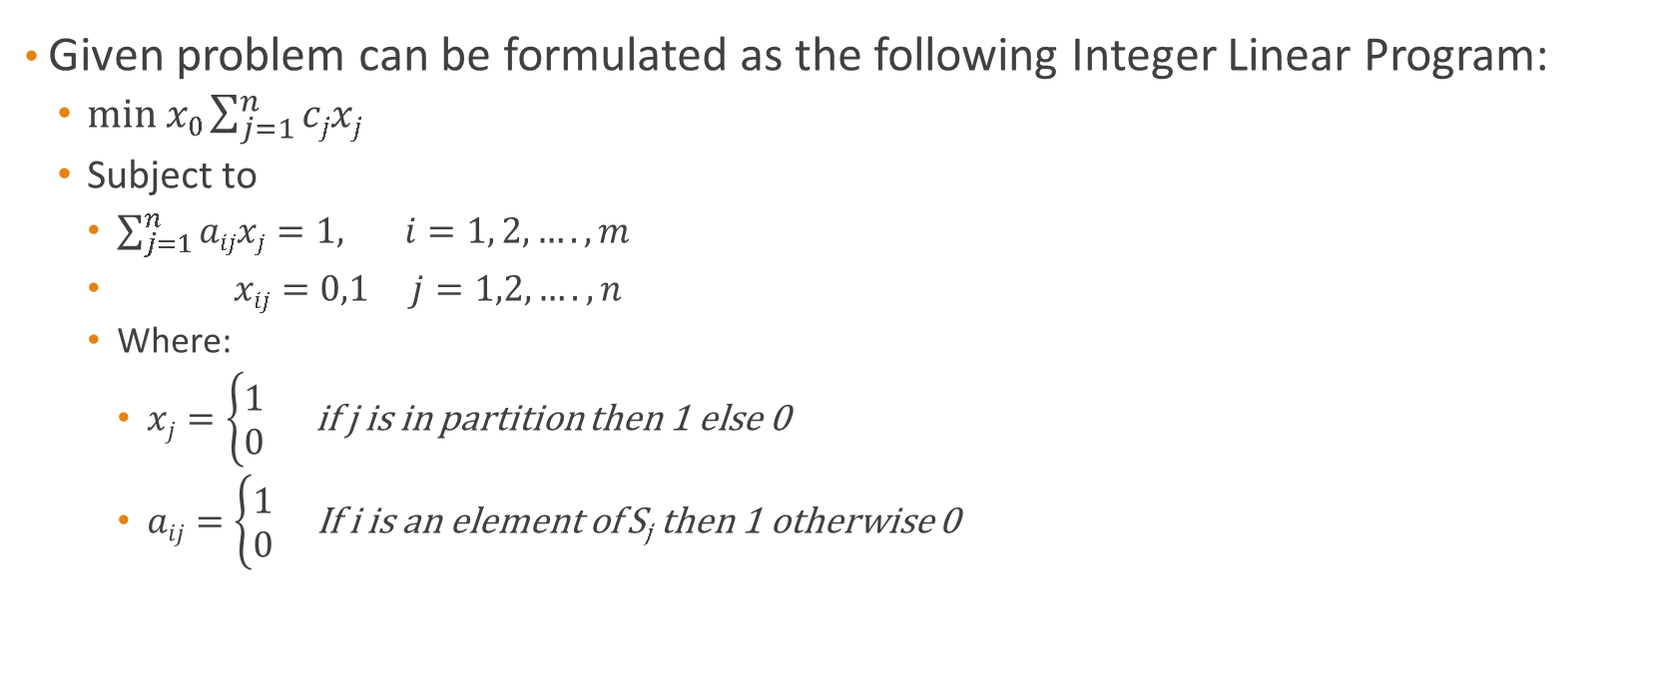
Solution Strategy
Given problem can be formulated as the following Integer Linear Program:
$min x0{\sum_{j=1}^{n}{cjxj}}$
Subject to
$\sum_{j=1}^{n}{aijxj=1, i=1, 2, …., m}$
$xij=0,1 j=1,2, ….,n$
Where:
$xj=\left\{\begin{aligned}1 \\ 0\end{aligned}\right.$ if j is in partition then 1 else 0
$aij=\left\{\begin{aligned}1 \\ 0\end{aligned}\right.$ If i is an element of S_{j} then 1 otherwise 0

Slide 6
1st Solution Strategy
Shifts as variable (either 0 or 1)
Set only one shift variable as 1 for every piece of work
When a shift variable is set to 1 all the other shift variables are set to 0
Another constraint added so that all the works are covered
2^{n} possible assignment of values to variables and n is the possible number of shifts

Slide 7
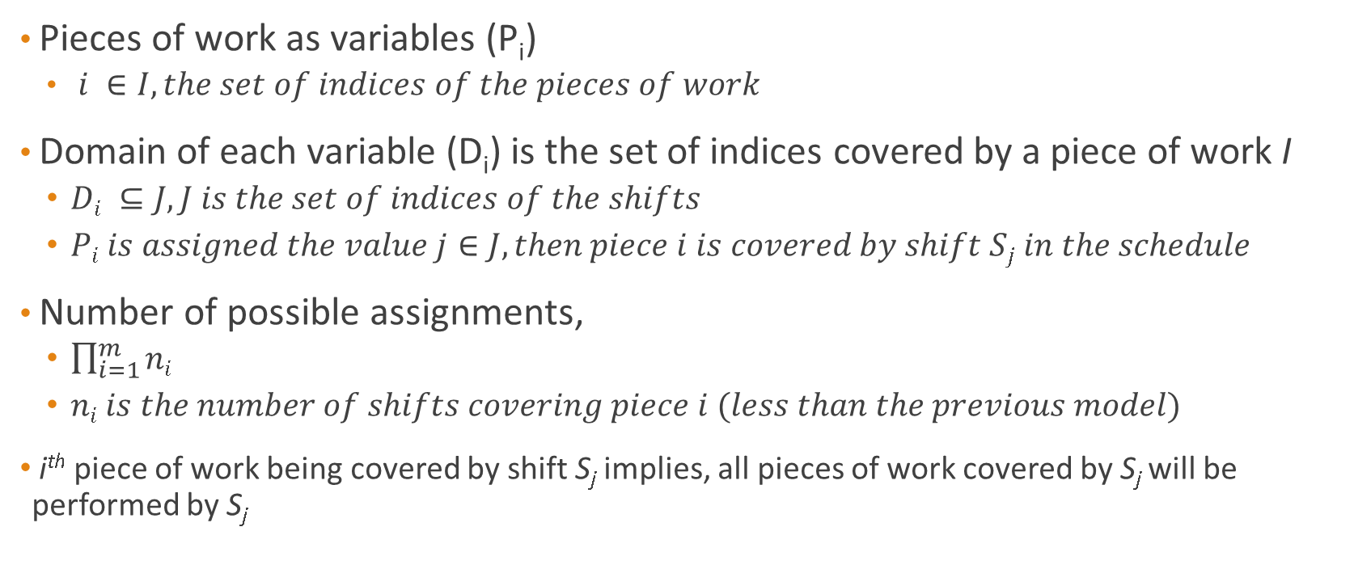
Improved Strategy
Pieces of work as variables (P_{i})
$i ∈I, the set of indices of the pieces of work$
Domain of each variable (D_{i}) is the set of indices covered by a piece of work I
$Di ⊆J, J is the set of indices of the shifts$
$Pi is assigned the value j∈J, then piece i is covered by shift Sj in the schedule$
Number of possible assignments,
$\prod_{i=1}^{m}{ni}$
$ni is the number of shifts covering piece i (less than the previous model)$
i^{th} piece of work being covered by shift S_{j} implies, all pieces of work covered by S_{j} will be performed by S_{j}

Slide 8

Continued …
Any piece of work such that
$j∈Dk, then must be Pk=k which gives the constraint:$
$\left(Pi=j\right)⟺\left(Pk=j\right) ∀ i,k ∈I such that, Di∩Dk≠ ∅, ∀j∈Di ∩Dk$
Meaning if piece i is assigned shift j
Then piece k will be assigned shift j

Slide 9
Sample Input
Pieces of Work | Total Number of Shifts | Minimum Number of Shifts to Cover All the Works
6 | 10 | 3
Cost Per Shift | Total number of works covered by the shift | Work pieces
1 | 2 | 0 1
1 | 3 | 1 3 4
1 | 2 | 3 5
1 | 4 | 1 3 4 5
1 | 3 | 0 3 5
1 | 2 | 2 4
1 | 5 | 0 1 2 3 4
1 | 3 | 0 4 5
1 | 3 | 1 3 5
1 | 2 | 2 5

Slide 10
Pseudo Boolean File (Generated)
min: +1*x1 +1*x2 +1*x3 +1*x4 +1*x5 +1*x6 +1*x7 +1*x8 +1*x9 +1*x10; (Goal Function)
+1*x1 +1*x5 +1*x7 +1*x8 =1;
+1*x1 +1*x2 +1*x4 +1*x7 +1*x9 =1;
+1*x6 +1*x7 =1;
+1*x2 +1*x3 +1*x4 +1*x5 +1*x7 +1*x9 =1;
+1*x2 +1*x4 +1*x6 +1*x7 +1*x8 =1;
+1*x3 +1*x4 +1*x5 +1*x8 +1*x9 =1;
-1*x1 -1*x2 -1*x3 -1*x4 -1*x5 -1*x6 -1*x7 -1*x8 -1*x9 -1*x10 >= -6; (All the works should be covered)
Each piece of work is covered by all the shifts in its domain

Slide 11
Sample Output (Generated By Minisat+)
x1 -x2 x3 -x4 -x5 x6 -x7 -x8 -x9 -x10
This shift is included in the final solution
This shift is not included in the final solution

Slide 12
Final Output
Task Covered Tasks
----------------------------
2 0 1
2 3 5
2 2 4

Slide 13
End!!!

